Slide 1



CPS 564 - Visual Computing & Mixed Reality
Assignment - 3
Team Members
Pratham Yadav
Jenil Pandya
Anant Chanchad
David Geis
Nikesh Chithambaram

Slide 2
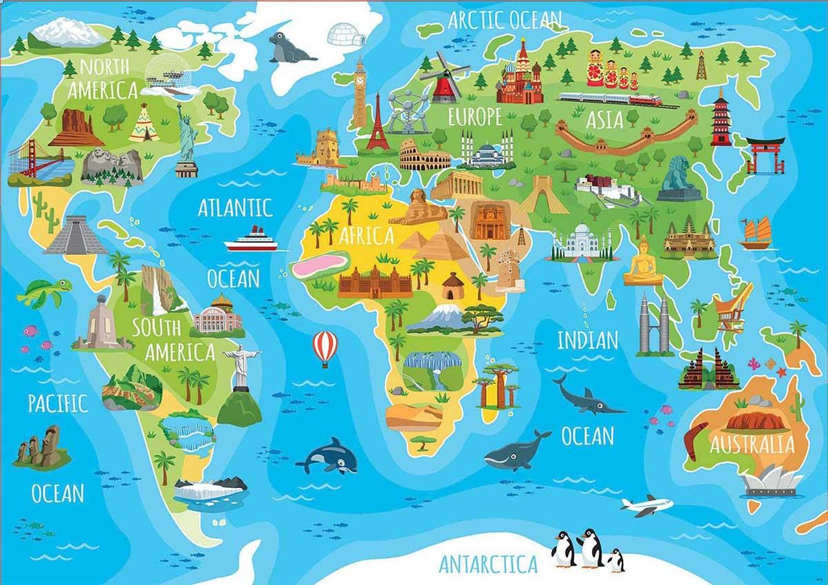
Problem
In this assignment, you will implement Augmented Reality (AR) application to visualize the landmarks of the world map such as Eiffel Tower, Golden Gate, Sydney Opera House, Taj Mahal, etc.

Slide 3
Analysis
Landmark Identification and Placement : Precisely coordinating and verifying geographical locations of landmarks on a digital map ensuring correct AR mapping.
Database Creation with Vuforia : Creating a Vuforia database to recognize and track the world map involved uploading the image, setting up image targets, and ensuring consistent recognition in varying conditions.
Animation in Unity : Implementing landmark animations in Unity required expertise in animation tools and ensuring smooth transitions and interactions without performance issues.
Acquiring and Preparing 3D Models : Finding appropriate 3D models online involved converting them to FBX format and modifying them in Blender to meet project requirements and ensure realistic AR representation.

Slide 4
Landmarks
Many 3D modeling websites were searched for free 3D models to represent the landmarks:
Free3d.com Sketchfab Unity Asset store Mixamo
CG trader Turbo Squid Mena Assets
14 Models were found and put on the world map
Colosseum
Kangaroo (Australia)
Aztec Pyramid
Buddha Statue
Chinese Guardian Lion
Christ the Redeemer
Egypt Pharaoh
Eiffel Tower
Liberty Statue
Lotus Temple
Petronas Twin Tower
Mount Rushmore
Taj Mahal
Moai
2 Bonus models were also placed on the map to make it more entertaining
Boy Character - Someone to welcome you to the world map by waving hello!
Airplane - An airplane to fly you around the world and show you all the exciting locations!

Slide 5
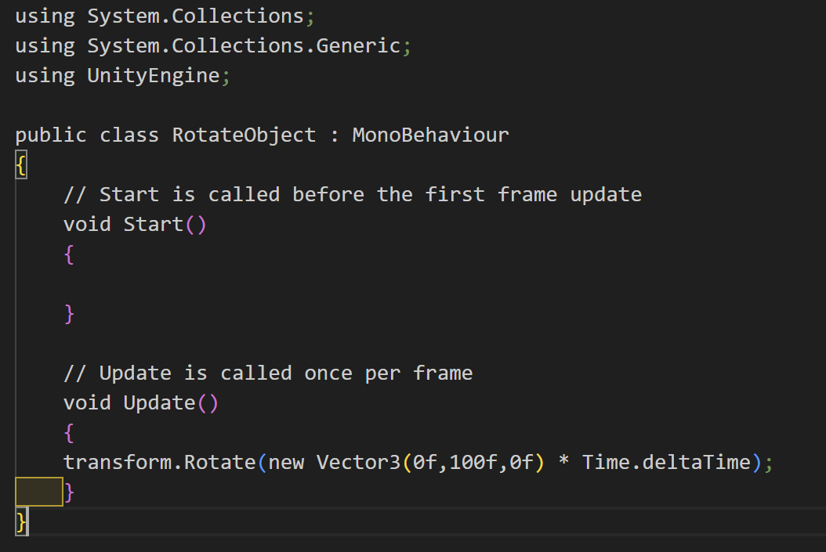
Code & Output
The following code helps us to rotate the objects on rendering in unity.

Slide 6
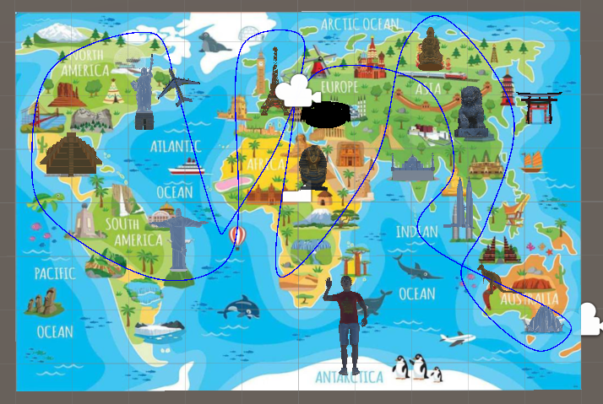
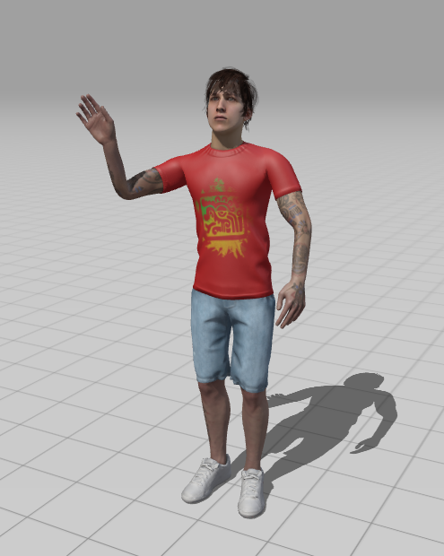
with Mixamo Character Animation Created a Boy doing Waving Animation
Created A Spline with Spline Tool and Implemented an Airplane Across that Created Spline

Slide 7
Features
Background Audio
We have added a background audio to provide an immersive experience. The audio plays as soon as the image target is detected.
Touchable objects
Taj Mahal and Statue of Liberty models have a trigger component which play some unique audio and particle effect on touch.
Spline Animation
An airplane object that flies around the map through a spline based animation.
Mixamo Character
A boy character imported from Adobe Mixamo with a waving animation applied.

Slide 8


Issues
01
02
03
04
Image Recognition Accuracy
Model Scaling and Positioning
Performance Optimization
Model Format Compatibility
The Vuforia engine sometimes struggled to accurately recognize the world map, especially when the lighting conditions were not optimal.
Ensuring that each 3D model of the landmarks was correctly scaled and positioned on the world map required precise adjustments and could be time-consuming.
Animating ten objects simultaneously in an AR environment caused performance issues, including lag and stuttering, especially on lower-end devices.
We found 3D models in various formats which needed to be converted to FBX format for compatibility with Unity. Additionally, some models required modifications in Blender.

Slide 9
Solutions
01
02
03
04
Improved Image Targets
Fine-Tuning in Unity
Performance Optimization Techniques
Model Conversion and Modification
Enhanced image recognition in Vuforia by selecting high-contrast, high-resolution map images and adjusting AR environment lighting.
Utilized Unity's scene view and coordinate system to manually adjust the scale and position of each landmark for accurate placement.
Optimized performance by simplifying 3D models and employing efficient coding practices.
Found and converted 3D models to FBX format for Unity and modified them in Blender to meet project requirements.

Slide 10

We Exported The Project Onto Android and Built it and Captured everything on Phone camera
Output Video

Slide 11


Thank You

